Slide 1

AI-Powered Smart Traffic Management
An intelligent traffic management system utilizing AI technology.

Slide 2

Multi-Camera Vehicle Detection
The system employs advanced AI technology to monitor up to four traffic cameras in real-time. Utilizing the YOLOv5 model, it achieves high accuracy in vehicle detection, tracking each vehicle with a unique ID through the SORT algorithm. This robust solution processes at an impressive rate of 30 frames per second for each camera, totaling 120 frames per second across all inputs.

Slide 3

Dynamic Signal Control
The dynamic signal control feature intelligently adjusts traffic signals based on real-time traffic density. Emergency vehicles are prioritized, receiving a 20-second head start when necessary. The system is designed to ensure that no lane waits more than three cycles during peak times, while also implementing a round-robin switching mechanism when traffic volume is low, effectively reducing congestion.

Slide 4
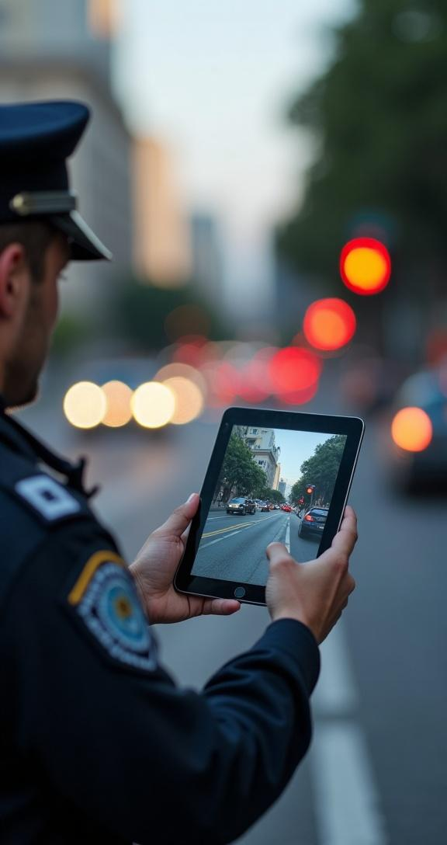
Automated Violation Detection
The automated violation detection feature accurately identifies red-light infractions with a remarkable 90% precision. The system captures photographic evidence in real time and generates e-challans in PDF format, complete with detailed violation information. Additionally, it estimates vehicle speed at the moment of the violation, ensuring a comprehensive approach to traffic law enforcement.

Slide 5
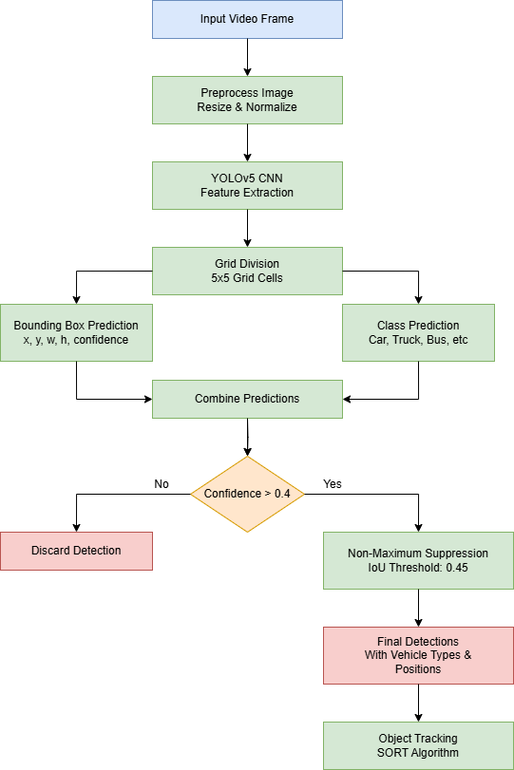
Detection Accuracy and Latency
The AI-driven system achieves a detection accuracy of 92%, ensuring reliable vehicle identification and monitoring. Processing latency is impressively low, at less than 100 milliseconds, allowing for real-time decision-making and response. This rapid processing helps maintain smooth traffic flow and minimizes delays at intersections.

Slide 6

Traffic Efficiency Statistics
The implementation of this smart traffic management system results in significant enhancements in traffic efficiency. It has demonstrated a 35% reduction in average wait times at traffic signals and an increase in intersection throughput by 28%. Furthermore, fuel consumption decreases by 25%, contributing to both cost savings and environmental sustainability.

Slide 7

EMERGENCY VEHICLE DETECTION
A real-time emergency vehicle recognition system leverages advanced AI models and computer vision techniques to accurately detect ambulances, fire trucks, and police vehicles from live traffic camera feeds. Upon identification, the system automatically overrides normal signal operations and activates green lights within 1 second, dynamically adjusting signal cycles to create a dedicated corridor for emergency passage.

Slide 8
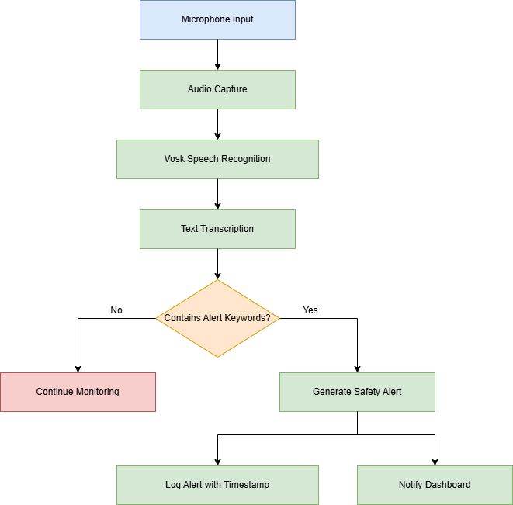
Women Safety Alert
An AI-powered audio surveillance system continuously monitors ambient sound at traffic intersections to detect distress calls such as "Help" or "Bachao" in real-time. Using advanced speech recognition and keyword detection, the system instantly triggers alerts to nearby authorities or control centers, enabling rapid response and enhancing women's safety in public spaces.

Slide 9

Conclusions
The AI-Powered Smart Traffic Management System presents a comprehensive solution for modern traffic challenges. By harnessing advanced technology for vehicle detection, signal control, and violation management, it significantly enhances operational efficiency, safety, and revenue generation while minimizing environmental impact.

Slide 10
Thank You!

